Slide 1
Detect
Deloitte’s solution implements security capabilities that can detect and alert when threats may occur
4
5
8b
2
1 | Device Anomaly Detection
2 | Asset Discovery & Device Threat Monitoring
3 | Vulnerability Management
4 | Logging and Monitoring
5 | Centralized Log Management
6 | Security Incident and Event Management
7 | Threat Detection & Compliance Monitoring
 | Edge Artificial intelligence & Threat Analytics
1
2
1
3
4
5
8a
6
7
3
6
8
7

Slide 2
Respond & Recover
Deloitte’s solution implements security capabilities to increase resiliency
7
1 | Fog Computing in LAN
2 | Sub/pub Topology
3 | Multi-region deployment
4 | Multi-AZ Deployment
5 | EBS Root Volume Backup
6 | Cross-region Replication
7 | Security Automation
8 | Workload and Process Decoupling
 | Breach detection and response
1
2
3
3
1
4
5
2
4
6
8
7
8
5
9
9
6

Slide 3
Azure IoT Capabilities

Slide 4
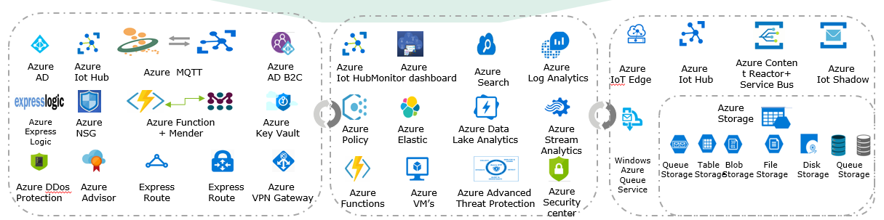
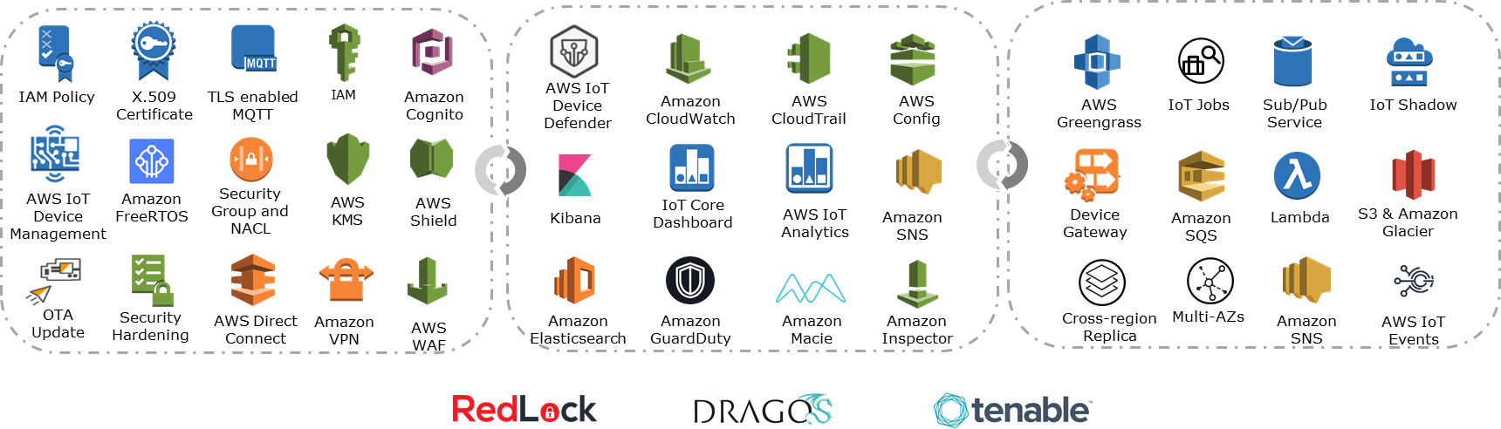
Deloitte’s Cloud IoT Cyber Framework
Business-driven risk framework aligned with strategic objectives to address IoT cyber challenges
Business Objectives
Growth &
Innovation
Operational
Efficiency
Brand
Protection
Risk-based
Decision Making
Compliance
Organization and Leadership
IoT Steering Committee
Cloud Center of Excellence
Information
Security
Application /
DevOps
Information Technology
Legal &
Compliance
Product
Procurement
Operating Model Components
Governance &
Oversight
Policies &
Standards
Management
Processes
Tools &
Technology
Risk Metrics &
Dashboard
.
.
.
.
.
Fundamental Components
Know your Device
Know your Cloud
Know your Data
Know your Customers
Know your Third-party
IoT Value Chain Perimeter
Device Layer
Edge Layer
Over the Air Layer
Cloud Layer
Application Layer
Prevention
Detection
Remediation
Device Hardening
Infrastructure & Network Security
Identity Management
and Access Governance
Data & Privacy Protection
Device Lifecycle
Certificate Management
Device & Asset Management
OS & App Security
Threat Intelligence
Compliance Monitoring
Anomaly Monitoring
Vulnerability Management
Centralized Logging
Risk Analytics
Security Incident & Event Management
Automated Remediation
Incident Response & Forensics
Digital Twin and Intermittent Connectivity
OTA and Remote Control
Architecture & Process Decoupling
Disaster Recovery and Foggy Continuity
High Availability & Redundancy
Cyber Risk Domains
Technologies and Tools
Notes:
Industry Standards
ISO¹ 27001/2
NIST² cybersecurity framework
Global privacy and data protection laws
ITIL³
^{Leading Practices}
Recognized information security leader
Project / engagement experience
Published industry research
Threat Landscape
Who might attack?
What are they after?
What tactics will they use?
¹ International Organization for Standardization
² National Institute for Standards and Technology
³ Formerly known as the Information Technology Infrastructure Library

Slide 5


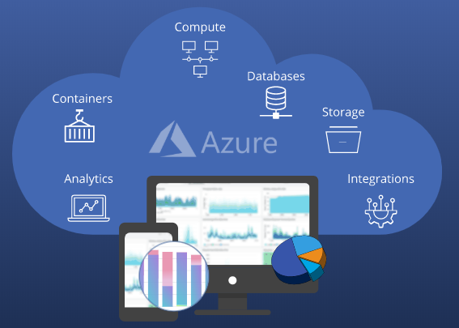



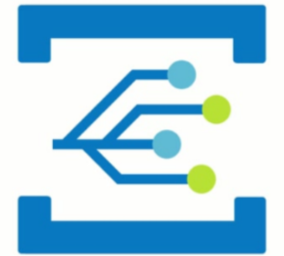

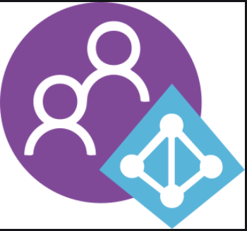











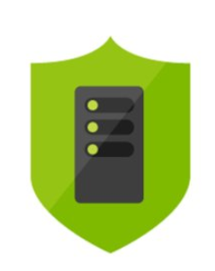




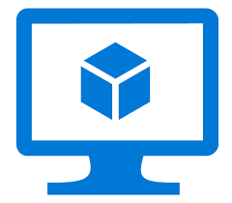
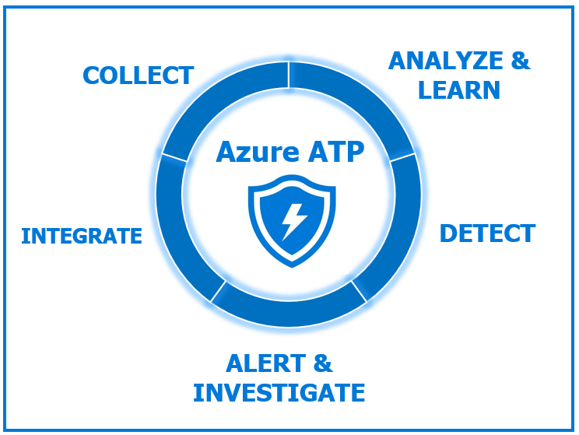



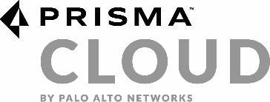

Deloitte’s Cloud IoT Cyber Framework supported Azure solutions stack
Leveraging Deloitte Cloud IoT Cyber Framework to create a secure IoT platform for your organization
IoT Value Chain Perimeter
Device Layer
Edge Layer
Over the Air Layer
Cloud Layer
Application Layer
Prevention
Detection
Remediation
Device Hardening
Infrastructure & Network Security
Identity and Context
Data& Privacy Protection
Access Management
Device Lifecycle
Certificate Management
Device & Asset Management
OS & App Security
Threat Intelligence
Compliance Monitoring
Anomaly Monitoring
Vulnerability Management
Centralized Logging
Risk Analytics
Security Information & Event Management
Automated Remediation
Incident Response & Forensics
Digital Twin and Intermittent Connectivity
OTA and Remote Control
Architecture & Process Decoupling
Disaster Recovery and Foggy Continuity
High Availability & Redundancy
Cyber Risk Domains
Azure
AD
Azure
IoT Hub
Azure MQTT
Azure
AD B2C
Azure
IoT Hub
Azure
Monitor dashboard
Azure
Search
Azure
Log Analytics
Azure
IoT Edge
Azure
IoT Hub
Azure Content Reactor+ Service Bus
IoT
Digital Twin
Technologies and Tools
Azure
Storage
Azure
Express Logic
Azure
NSG
Azure Function
+ Mender
Azure
Key Vault
Azure
Policy
Azure
Elastic
Azure Data
Lake Analytics
Azure
Stream Analytics
Windows Azure Queue Service
Queue
Storage
Table
Storage
Blob
Storage
File
Storage
Disk
Storage
Azure DDos
Protection
Azure
Advisor
Express
Route
Express
Route
Azure
VPN Gateway
Azure
Functions
Azure
VM’s
Azure Advanced
Threat Protection
Azure Security center

Slide 6








Azure IoT core backbone architecture
Reference architecture that emulates a real IoT solution in the field
User Management
Azure AD
IoT Edge devices
Cloud gateway
IoT Hub
UI Reporting and tools
Stream processing and rules evaluation over data
management
Device
management
IoT devices
Visualize data and learning
Stream Processing
Stream Analytics
Business integration
Logic app
Bulk device provisioning
IoT DPS
Data transformation
Function App
Warm patch store
Cosmos DB
Cold path store
Storage blob
Machine Learning
Azure machine learning
Store
data
Integrate with business process
Things
Insights
Action
Data flow and traffic

Slide 7
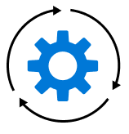

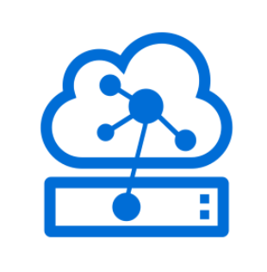



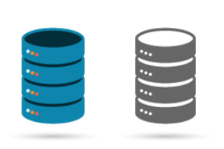




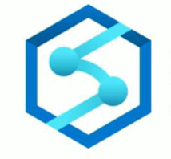
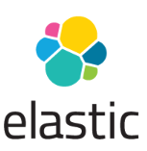

Azure IoT data value chain
Data generated from the Edge is transmitted, processed, transformed, stored, and analyzed in the cloud, providing end to end security from device to the cloud
4. Stream high-velocity data via Azure stream analysis for real-time monitoring
Edge
Cloud
4
Azure availability zones
Web layer
Zone 1
Vm’s
Scale
set
Zone 2
End points
Load
balancer
Azure content reactor
Azure Event hub
Cloud gateway
IoT Hub
secure
Device management &monitoring
Azure Advanced Threat Protection
Application layer
IoT Edge devices
Azure IoT Edge
Azure Queue Service
Azure
Function
Database layer
Azure Policy
5. Stream high-velocity data Azure stream analytics
1. Store device data to NoSQL Blob DB for data parsing
Blob storage
File storage
Analytics
2
5
Azure IoT device management
UI Reporting and tools
2. Store data in different data sets via data pipelines for analysis
Storage layer
Sensors and IoT devices
1
Azure stream analytics
3
Azure twin devices
6
Azure search
Data Lake analytics
Azure synapse
Blob
storage
Log
analysis
6. Visualize data in ELK stack
3. Analyze data in Azure analysis, synapse to aid reporting and decision making

Slide 8

















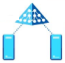



Identify & Protect
Deloitte’s solution offers a wide breadth of security capabilities that aim to prevent attacks by implementing preventative security controls
Edge
Endpoints
3
1 | Multi-factor Auth
2 | WAN Security
 | Non-Default Credentials
 | Identity Management and Access Governance
 | Network security & Traffic monitoring
 | Intrusion Prevention & Whitelisting
 | Device Identity and Encrypted Transmission
 | Data Protection and Certificate Management
6
1
Edge
Gateway
2
Azure IoT
Hub
Log
analysis
Azure IoT Edge
Firewall
3
2
8
4
1
5
7
VPN
gateway
Azure
Express route
Azure key vault
5
Azure MFA
Azure IoT certificate
Azure IoT certificate
Azure Policy
Azure TLS support
6
Azure Security groups
IoT Interface
Layer
Azure HSM
7
Pipeline and ingestion layer
Web
Layer
8
Azure AD
4
Business Analytics & intelligence Layer
NACL (subscription and control )
Azure API management
Resource
group
IAM
Azure IoT
Hub
Database Layer
Application
Layer
Federation
Azure Policy
Object storage Layer
Azure CDN
Azure DDos

Slide 9














Detect
Deloitte’s solution implements security capabilities that can detect and alert when threats may occur
4
5
Endpoints
Application Gateway
Load
balancer
Azure monitor
2
Notification
Hub
8b
2
1 | Device Anomaly Detection
2 | Asset Discovery & Device Threat Monitoring
3 | Vulnerability Management
4 | Logging and Monitoring
5 | Centralized Log Management
6 | Security Incident and Event Management
7 | Threat Detection & Compliance Monitoring
 | Edge Artificial intelligence & Threat Analytics
Edge
Gateway
1
Azure policy
Azure search
2
Azure functions
Stream Analytics
Real time analytics
Time series data
Tenable Vulnerability Scanning
Azure DDos
Stream Analytics
1
Log
analysis
3
Azure CDN
4
Azure Security center
Blob
storage
5
Azure Reactor
Azure IoT
Hub
Azure monitor
Event Hub
8
Big Data stores
6
IoT Interface
Layer
Pipeline and ingestion layer
7
Web
Layer
Big Data
stores
Blob
storage
Data
Factory
Machine Learning
(Anomaly Detection)
Business Analytics & intelligence Layer
8
3
6
8
Azure
AD
Azure IoT
Hub
Database Layer
Tenable Vulnerability Scanning
Azure Insights (Monitoring and telemetry)
Azure SquaredUp
Application
Layer
Object storage Layer
7
Azure Advanced Threat Protection
Azure Security center
Azure Policy
Prisma cloud

Slide 10



Respond & Recover
Deloitte’s solution implements security capabilities to increase resiliency
Edge
7
1 | Fog Computing in LAN
2 | Sub/pub Topology
3 | Multi-region deployment
4 | Azure high availability Deployment
5 | Volume Backup
6 | Cross-region Replication
7 | Security Automation
8 | Workload and Process Decoupling
 | Breach detection and response
Endpoints
1
2
3
Azure IoT hub
Stream Analytics
Azure SquaredUp
1
3
Edge
Gateway
4
Azure DNS
Azure IoT hub
Azure functions
Stream Analytics
5
Cloud
4
6
Load
balancer
8
2
Default
Region
8a
7
8
Azure messaging
Web App1
Web App1
Azure functions
Azure search
Azure Queue Service
8
9
Load
balancer
Cold, Hot, standby failover Region
IoT Interface
Layer
Pipeline and ingestion layer
9
Business Analytics & intelligence Layer
App1
Failover App
Azure
AD
Azure Security center
Prisma cloud
Azure IoT
Hub
File storage
Object storage Layer
Master
DB
5
Azure Advanced Threat Protection
Azure Policy

Slide 11




Deloitte Cloud & IoT Cybersecurity and Privacy
Our relationship brings together Deloitte’s leadership in cyber and enterprise risk management with the security-enabled cloud infrastructure of AWS. In 2006, AWS began offering IT infrastructure services to businesses in the form of web services—now commonly known as cloud computing. Today AWS provides a highly reliable, secure, scalable, low-cost infrastructure that powers hundreds of thousands of businesses in 190 countries around the world, with over a million active customers spread across many industries and geographies.
Deloitte can help organizations adopt Cloud and IoT and establish a security-first AWS IoT strategy. Deloitte is a leading information technology and advisory company, ranked #1 globally in 2017, in Security Consulting by Gartner (Gartner: Market Share: Security Consulting Services, Worldwide, 2016). Deloitte is an AWS Premier Consulting Partner and was one of the first eight organizations globally to achieve the Security Competency as a launch partner. Deloitte’s vast experience in life sciences and health care, automotive, and industrial control system, combined with its extensive experience with digital transformation, enable us to provide end-to-end infrastructure cyber risk solutions for Smart Cities.
Sean Peasley
Partner, Cyber Risk Services
Deloitte & Touche LLP
IoT Security Leader
speasley@deloitte.com
Kieran Norton
Principal, Cyber Risk Services
Deloitte & Touche LLP
Cloud Infrastructure Leader
kinorton@deloitte.com
Aaron Brown
Partner, Cyber Risk Services
Deloitte & Touche LLP
AWS Alliance Leader
aaronbrown@deloitte.com
Ravi Dhaval
Senior Manager, Cyber Risk Services
Deloitte & Touche LLP
Cloud & IoT Security Architect
rdhaval@deloitte.com

